Slide 1


Decision Trees (CART Models)

Slide 2
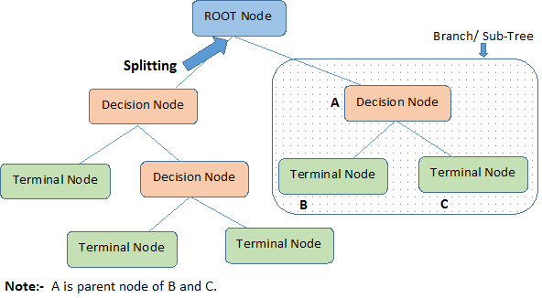

Clustering
Important Terminologies
Root Node: It represents entire population or sample and this further gets divided into two or more homogeneous sets.
Splitting: It is a process of dividing a node into two or more sub-nodes.
Decision Node: When a sub-node splits into further sub-nodes, then it is called decision node.
Parent and Child Node: A node, which is divided into sub-nodes is called parent node of sub-nodes where as sub-nodes are the child of parent node.
Leaf/ Terminal Node: Nodes do not split is called Leaf or Terminal node.
Pruning: When we remove sub-nodes of a decision node, this process is called pruning. You can say opposite process of splitting.
Branch / Sub-Tree: A sub section of entire tree is called branch or sub-tree.

Slide 3
Clustering
Advantages/ Dis-advantages
Advantages
Easy to Understand: Decision tree output is very easy to understand even for people from non-analytical background.
Less data cleaning required: It requires less data cleaning compared to some other modelling techniques. It is not influenced by outliers and missing values to a fair degree.
Data type is not a constraint: It can handle both numerical and categorical variables.
Non Parametric Method: Decision tree is considered to be a non-parametric method. This means that decision trees have no assumptions about the space distribution and the classifier structure
Disadvantages
Over fitting: Over fitting is one of the most practical difficulty for decision tree models. This problem gets solved by setting constraints on model parameters and pruning (discussed in detailed below).
Not fit for continuous variables: While working with continuous numerical variables, decision tree looses information when it categorizes variables in different categories.

Slide 4
Clustering
How the Nodes Split ?
Gini Index
Measure of Impurity
Defined as the probability of randomly assigning a category to a variable * probability of that assignment being incorrect
Works best for categorical variables
Higher the value of Gini Index, more impure the data space
Example
Process
Calculate Gini Index/ Entropy of parent node
Split parent node on the basis of multiple dimensions
Calculate the Gini Index/ Entropy for child nodes
Calculate the weighted average of all child nodes available in the split
Take the difference of Gini Index/ Entropy between parent and child nodes.
Student Split across class & Gender | 9th | 10th
Male | 8 | 12
Female | 6 | 4
Cricket Split across class & Gender | 9th | 10th
Male | 5 | 8
Female | 1 | 1
Entropy
Measure of Impurity
Higher the value of entropy, more impure the data space
Formula

